Slide 1

Green Pace
Security Policy Presentation
Developer: Trevor Peck

Slide 2
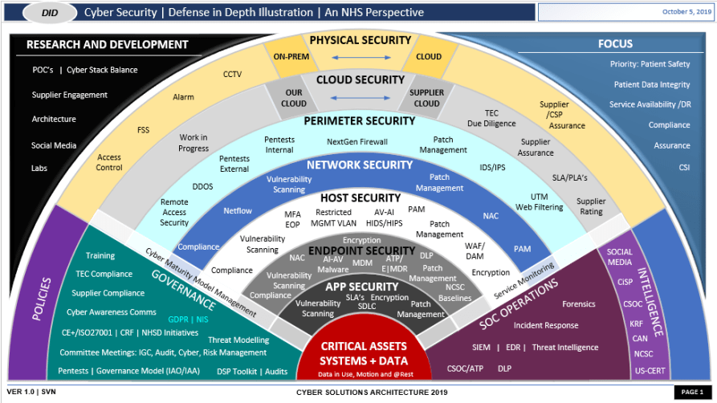
OVERVIEW: DEFENSE IN DEPTH
My security policy involves automation of defense in every level of depth in our system. Automation of defense will ensure that each layer is properly tended to, without creating too much of a time crunch.

Slide 3
THREATS MATRIX
Likely These threats appear often | Priority Most dangerous if the threat is not prevented
Low priority Shouldn’t cause major harm. E.g. formatting warnings | Unlikely These threats don’t appear very often

Slide 4
10 PRINCIPLES and corresponding coding standards
Principle | Standard | Justification for connection
Validate Input Data | ERR-62-CPP: Detect errors when converting a string to a number | Input validation that require a certain data type such as a number is a requirement for the function to work properly. Invalid input will not be able to convert to an integer, thus breaking the functionality of the code.
Validate Input Data | IDS-00-J: Prevent SQL Injection – Prevent attackers from using SQL queries | Validating that an input does not include an SQL query is a mandatory requirement for secure systems connected to databases, such as login pages. Detecting and handling SQL query attempts from input fields helps to prevent database access from attackers.
Heed Compiler Warnings | MSC-52-CPP: Value-returning functions must return a value from all exit paths | This type of standard is usually detected by the compiler, as all exit paths should be required to return a specified value. Not returning a value from a function practically renders the callee inert to the caller if it the caller is meant to use the returned value in some way.
Architect and Design for Security Policies | MET01-J: Never use assertions to validate method arguments. | The architecture of validation should never rely on assertions for a release build. Assertions should only be used for testing purposes. The design should never rely on them to handle it in a real scenario. Often, assertions are not included in release builds, and therefore the system would then contain holes in logic.
Sanitize Data Sent to Other Systems | API-07-C: Enforce Type-safety | Type-safety is an important thing to validate before sending it to an endpoint, because if the endpoint receives the wrong type, a type error will occur. Usually, this should be taken care of within the function that returns the type (the callee).
Sanitize Data Sent to Other Systems | ERR-62-CPP: Detect errors when converting a string to a number | Conversion of data-types is another threat to type-safety if the types are non-convertible. Handling this error before sending it to another system is mandatory, as the system is expecting a certain data-type.
Sanitize Data Sent to Other Systems | IDS-00-J: Prevent SQL Injection – Prevent attackers from using SQL queries | Rendering an SQL injection ineffective before sending data to another server such as an SQL database is an effective sanitation method for disallowing queried access.
Use Effective Quality Assurance Techniques | MEM-52-CPP: Detect and handle memory allocation errors. | Avoiding memory allocation errors is a QA technique that protects against more than one threat, including system stability, and overflow injection as examples. Making sure that memory is allocated for all data recipients is part of the process that must not be overlooked.
Adopt a Secure Coding Standard | MSC-52-CPP: Value-returning functions must return a value from all exit paths | It’s a standard requirement to return values from value-returning functions, in order to ensure code sanity / error-prevention.

Slide 5
10 PRINCIPLES and corresponding coding standards pt. 2
Principle | Standard | Justification for connection
Adopt a Secure Coding Standard | MET01-J: Never use assertions to validate method arguments. | Standardizing checks for validation of method arguments does not include using assertions. Assertions are for Unit Testing, and cannot be the method of validation for a release build.
Adopt a Secure Coding Standard | ERR-51-CPP: Handle all exceptions | Exceptions are a great way to keep a program stable in the case of errors, however, that tool should not be abused for its simplification. Handling all thrown errors properly is important to reroute a sequence. If an exception is left to a generalized catch-all statement, a sequence will simply not crash the program that instant, but it may behave unexpectedly later. All exceptions that are thrown should have their own corresponding catch block in order to keep a program on a stable track. The goal is to reroute an error, not to dismiss it.
Adopt a Secure Coding Standard | EXP-30-C: Do not depend on the order of evaluation for side effects. | Explicit order of evaluation is going to behave as expected rather than relying on a presumed order. Programs may behave unexpectedly if left to its own order. Therefore standardizing the order in which operations are completed is key to consistent outcome.

Slide 6
CODING STANDARDS
Rule | Severity | Likelihood
API-07-C: Enforce type safety. | Medium | Unlikely
MSC-52-CPP: Value-returning functions must return a value from all exit paths | Medium | Probable
ERR-62-CPP: Detect errors when converting a string to a number. | Medium | Unlikely
IDS-00-J: Prevent SQL Injection – Prevent attackers from using SQL queries | High | Probable
MEM-52-CPP: Detect and handle memory allocation errors. | High | Likely
MET01-J: Never use assertions to validate method arguments. | Medium | Probable
ERR-51-CPP: Handle all exceptions. | Low | Probable
EXP-30-C: Do not depend on the order of evaluation for side effects. | Medium | Probable
OOP-58-CPP: Copy operations must not mutate the source object. | Low | Unlikely
CTR-52-CPP: Guarantee that library functions do not overflow | High | Likely

Slide 7
ENCRYPTION POLICIES
Encryption type | Explanation & how it applies
Encryption in rest | Encryption in rest is a way of storing information in a secure format, on a long-term storage media. If preventative security measures fail, this is the last barricade of defense.
Encryption at flight | Encrypting data before it’s sent over the internet prevents attackers from stealing the contents of the packets and using them for malicious intent.
Encryption in use | Prevents data from being read when accessed by users with permissions. E.g. database administrators can perform commands on a database, but cannot read encrypted passwords from the database.

Slide 8
TRIPLE-A POLICIES
Authentication- Require users to prove their identity, and verify that identity.
Authorization- Utilize limited privileges and assign them to users. Deny all actions by default, only allowing specific actions based on user privilege
Accounting- Log all actions that occur on the server and associate them with the user that executed them.

Slide 9
Unit Testing
As an example of testing efforts to be automated using c++ tools, I chose to manually test the coding standard: CTR-52-CPP: Guarantee that library functions do not overflow. The expectations of tests may not be correct using regular assertion statements in Unit Tests, but may be caught by automated detection.

Slide 10
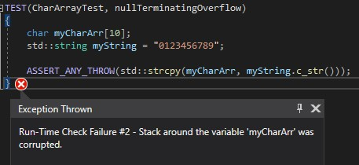
Test #1: We expect std::strcpy() to throw an exception if a char array’s bounds are smaller than a copied string. Note: strings are null-terminated, which is why this should overflow.
Result: No exception thrown because the call stack becomes corrupted, and the program’s security is compromised.

Slide 11

Test #2: “Safer” std::string class’ append() doesn’t overflow
Result: Can still overflow if the string is large enough

Slide 12

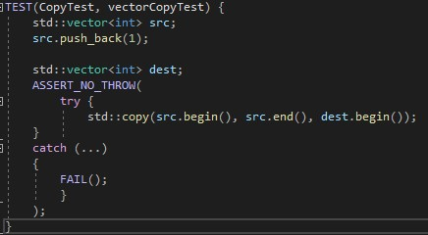
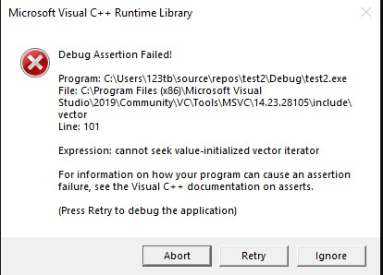
Test #3: std::copy() on two vectors will throw an exception when source is larger than destination
Result: Test cannot throw an exception because the call stack becomes corrupted, therefore
security is compromised
Even a try-catch block cannot handle this type of exception.

Slide 13
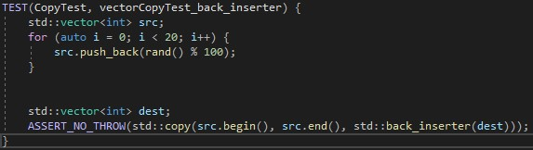

Test #4: std::copy() with 3rd argument std::back_inserter(dest) should fix the overflow
Result: std::back_inserter() dynamically allocates space thus preventing overflow.

Slide 14
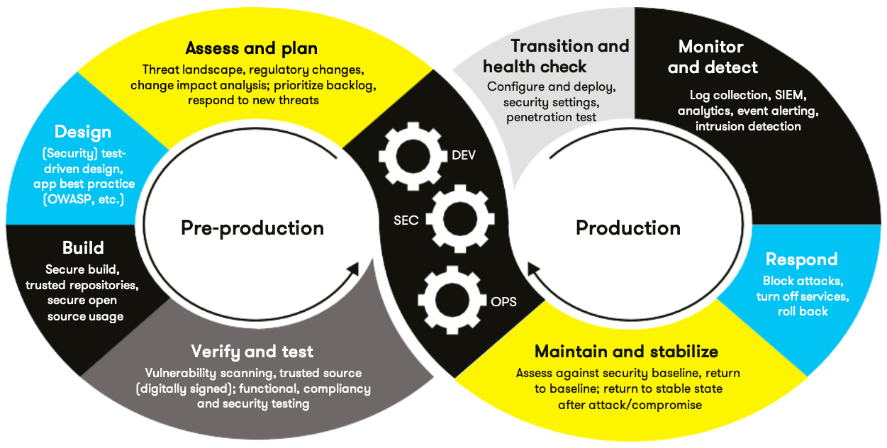
AUTOMATION SUMMARY

Slide 15
TOOLS and process of DevSecOps
  DevSecOps is the integration of automated security tools into the development process. The DevSecOps pipeline is the sequential development strategy that incorporates defense in depth.
  Design- Test-driven development can be enforced by writing test cases and using IDE tools to automate the process. This will ensure that expectations are met, and edge cases are handled.
  Build- Repository use can be utilized to handle secure transfer and storage of builds, both for testing and production.
  Verify and Test- Language-specific tools such as CPPCheck for C++ can detect code vulnerabilities better than the typical IDE, and Unit Testing will ensure code satisfies security and functionality requirements.
  Transition and health check- Professional penetration testing and security evaluation
  Monitor and detect- background scanning for potential checks, using persistent software
  Respond- Scheduled backups combined with rollback potential can prevent permanent damage to the system.
  Maintain and stabilize- Threat modeling combined with continued integration of automated security measures will keep our security up-to-date in the ever-evolving cat and mouse chase of system security.

Slide 16
RISKS AND BENEFITS
Should we act now, or wait?
Act Now
Wait
Risks | Benefits
Lots of extra time and work | Prevent attacks from ever happening
Can be expensive on the budget | Thorough measures are most impenetrable
Efficiency & time complexity will be slower | We will always have the upper hand
Integration issues may occur | Customers will have more peace of mind
Complexity increases, which naturally leads to more bugs that need fixing | Least likely to end up on the news and lose millions in reparations
Risks | Benefits
Customers cannot trust us with any personal information | Rapid prototyping
Rewriting code to be secure can create tons of new issues | Less expense
Will inevitably miss security holes because many are discovered during development | Less complexity
Likely to lose millions in reparations when things go awry | Easier integration
System will be penetrated very quickly | Faster time complexity and efficiency

Slide 17
RECOMMENDATIONS
    The worst thing about this policy is that it will take a lot of time and effort to implement. Building a foundation like this is going to delay any sort of prototype to show, which could cause lots of “How’s it coming along? It’s been a while and we haven’t seen much” with other departments.
    To decrease loss of enthusiasm, I suggest notifying other departments of the change and making sure they understand the time and cost of DevSecOps’ initial implementation. Note that this security implementation is a long-term strategy that will automate security, thus giving the team more time to work on new features later on. More time now, less time and worry later.
    This being said, I suggest thorough planning with tons of consideration before beginning the project. This larger assessment and planning time-span will help prevent missing anything now, which will create a wider foundation for the project. However, give the team realistic goals.
    I suggest two teams work collaboratively, one to automate security, and one to continue the project using manually implemented security standards. The main dev team should notify the security automation team of time-consuming efforts, and the security automation team should work on automating those efforts in order to quicken development while also integrating DevSecOps.

Slide 18
CONCLUSIONS
Secure coding standards that will prevent system crashes are the most important things to work on at the get-go. Preventing easily fixable, high-severity and high-likelyhood errors should be at the forefront of the project, and the integration of automated tools now instead of later will help us accomplish that. Unit Testing is still the main source of secure workflow.
Thoroughness is the main ideology of defense in-depth.
DevSecOps is a long-term security measure that will give the project a snowball effect that will be extremely robust, knocking down any and all threats in its path.
This is a necessary effort, because in this day and age, too many big companies are being attacked and losing massive amounts of money. This isn’t just software security, this is JOB security.
DevSecOps is a rapid-development strategy in disguise. Automated testing will actually speed up workflow upon integration. Eventually we will be able to pump out new features quickly and still be extremely secure at the same time.

Slide 19
REFERENCES
“Confluence.” SEI External Wiki Home - Homepage - Confluence, wiki.sei.cmu.edu/confluence/display/HOME.

